Slide 1
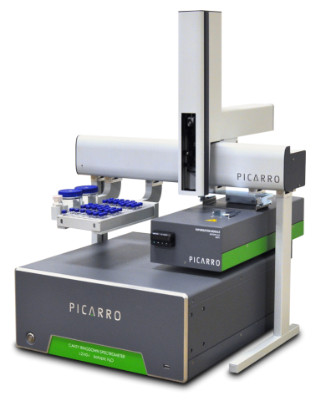
Simplifying Cavity Ring-Down Spectroscopy for Broader Audiences
Zachary Steele
20 – April – 2023

Slide 2
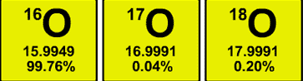
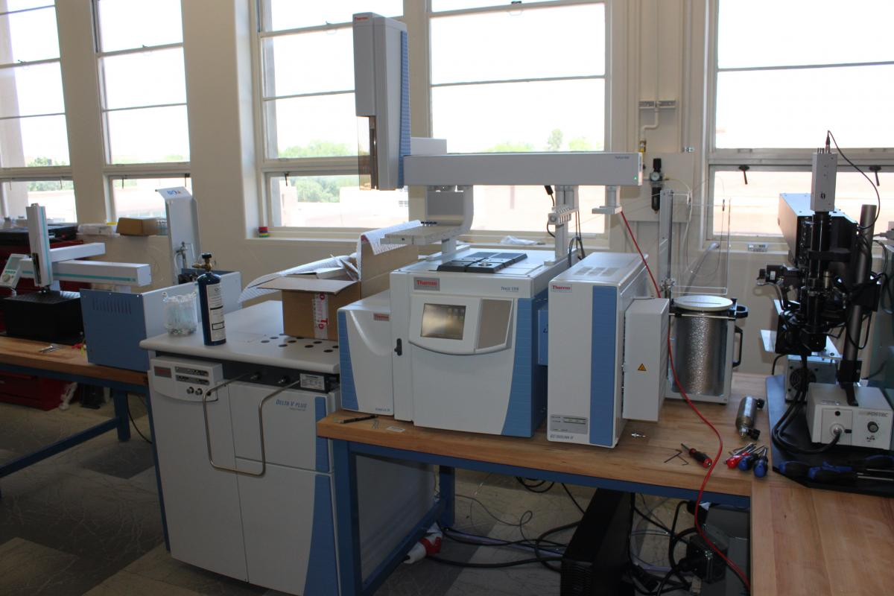
¹⁶O
¹⁷O
¹⁸O
∆¹⁷O
Time consuming
Expensive
Labor intensive

Slide 3
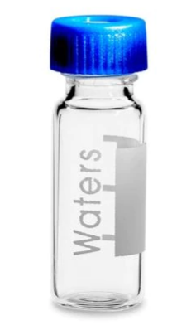
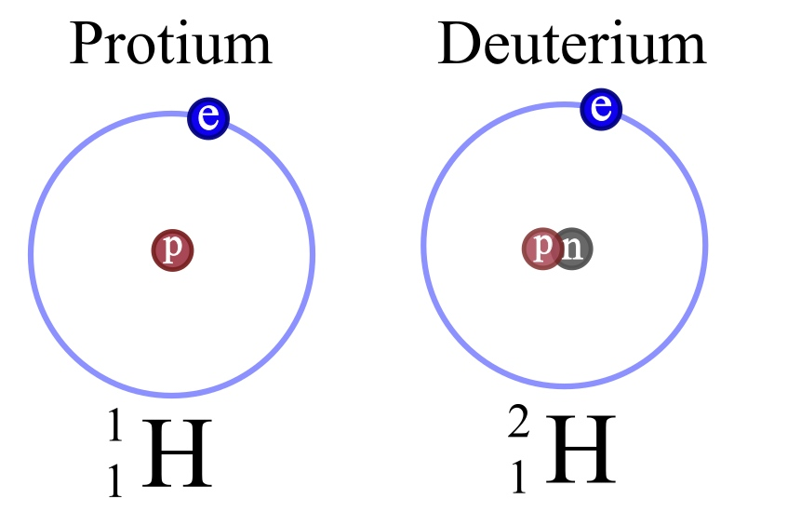
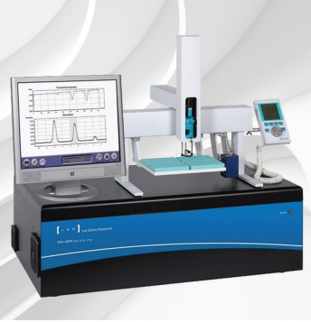
¹⁶O
¹⁷O
¹⁸O
¹⁸O
²H
∆¹⁷O
d-excess
Fast sample processing
Affordable
Nearly autonomous

Slide 4
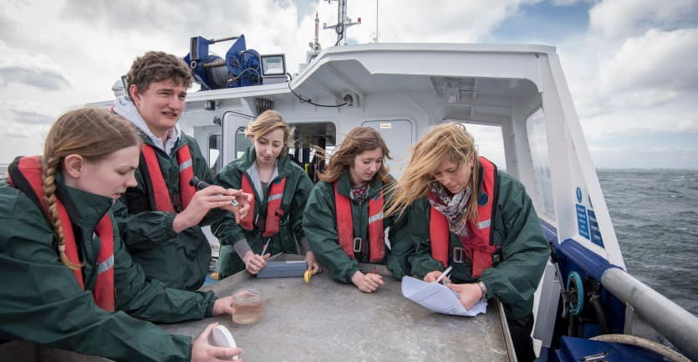
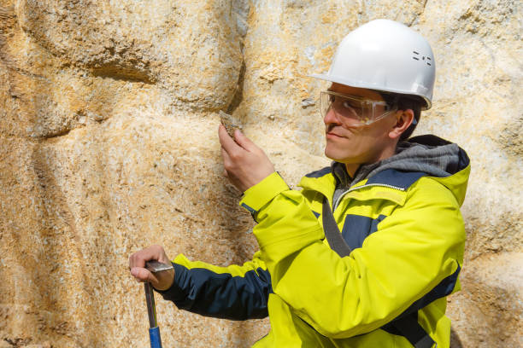
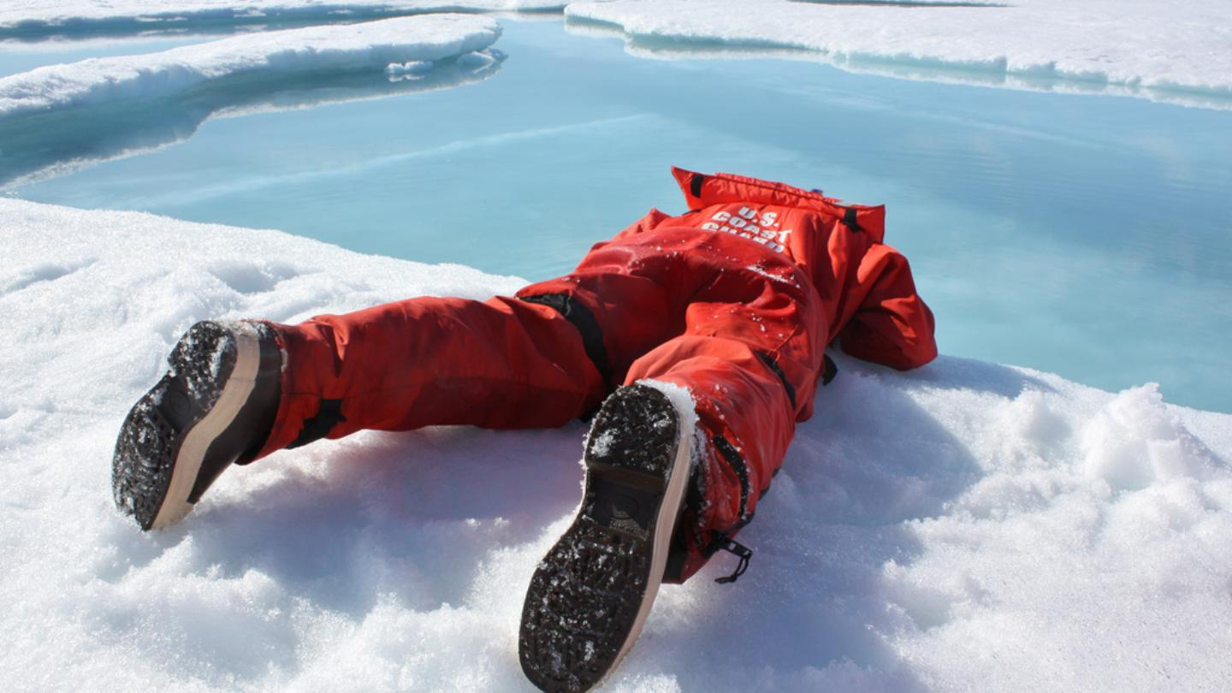


Slide 5
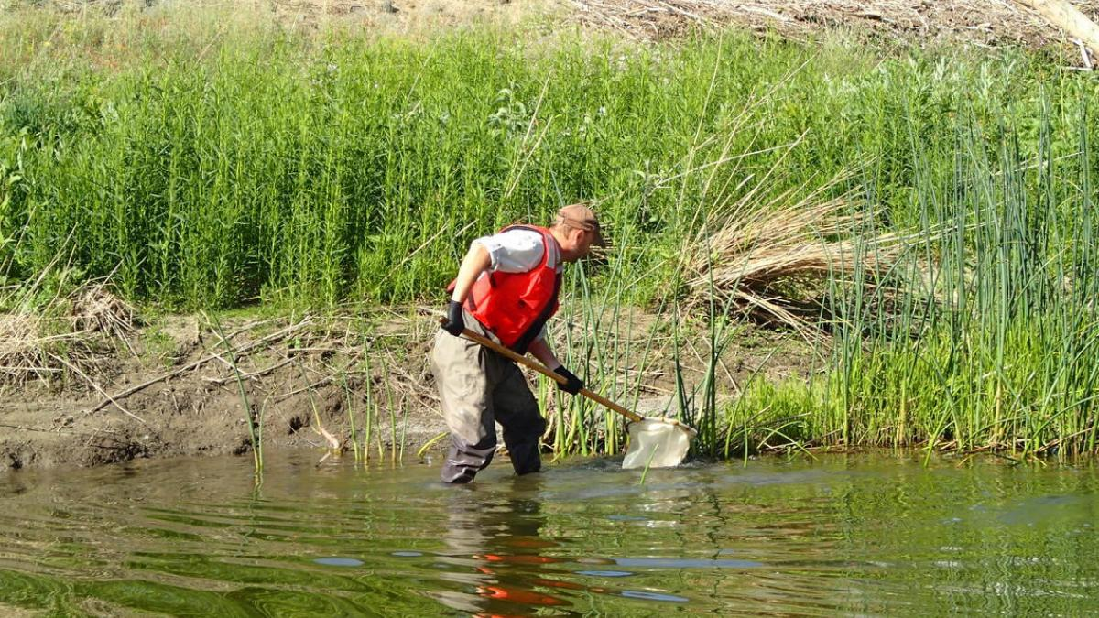
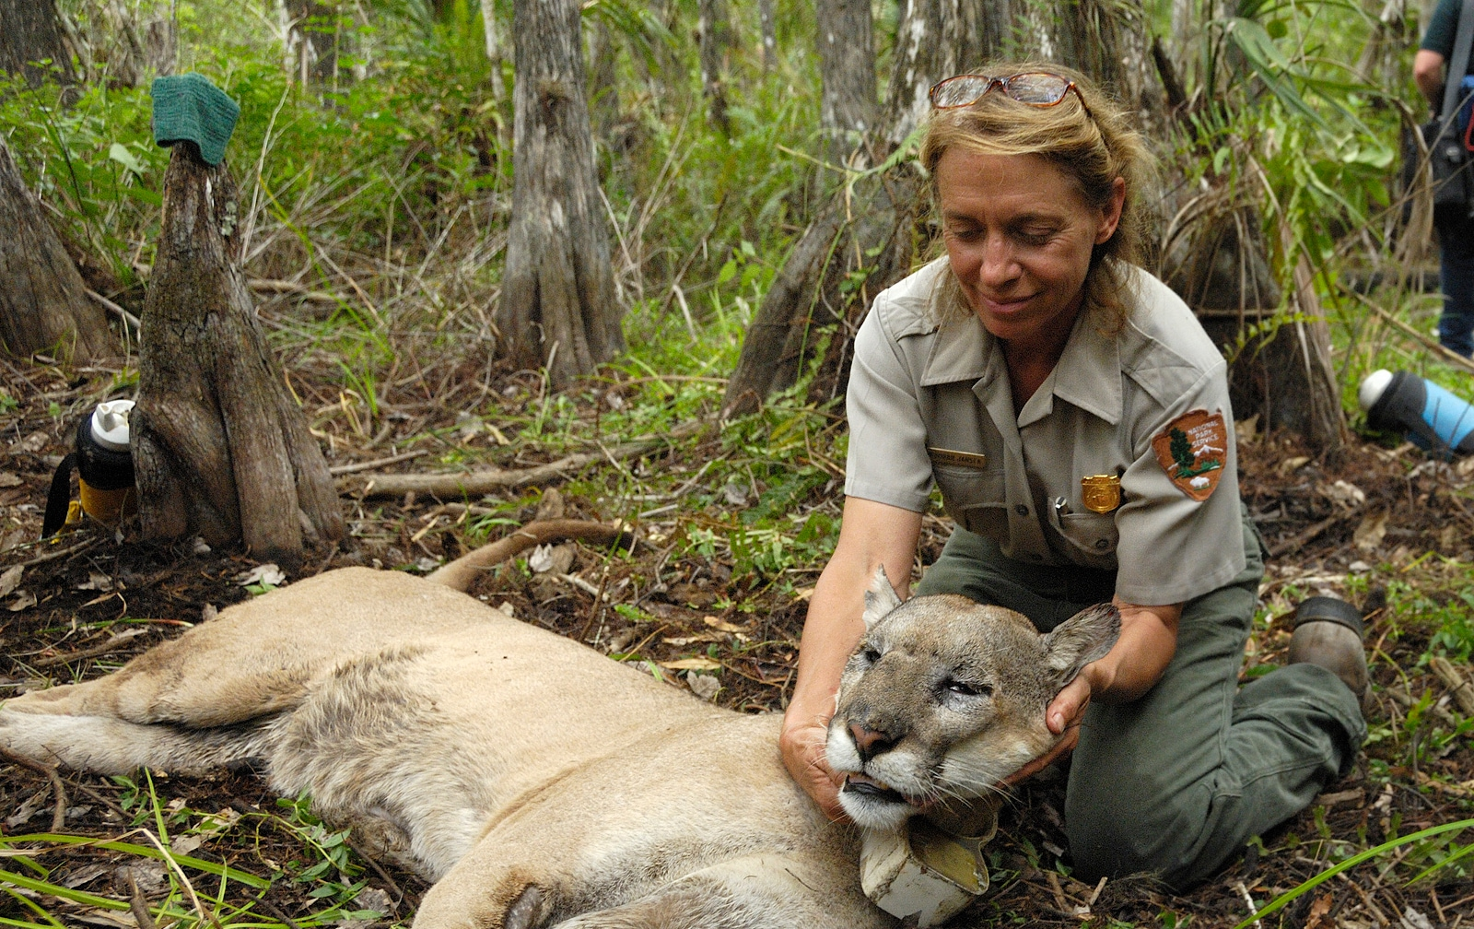
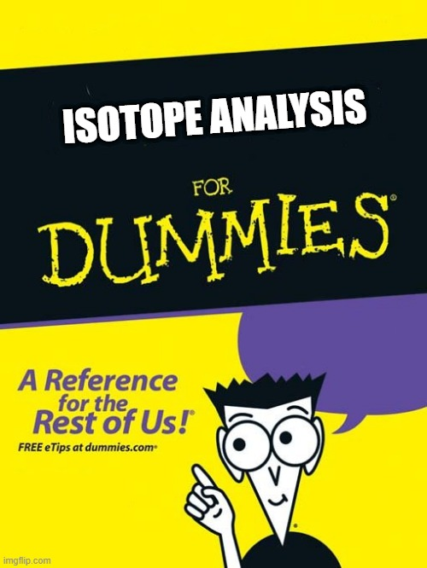

Slide 6
Current Barriers
Creating efficient sample processing
Confusing isotope terminology
Instrumentation
Complex post-processing

Slide 7
Current Barriers
Creating efficient sample processing
Confusing isotope terminology
Instrumentation
Complex post-processing

Slide 8
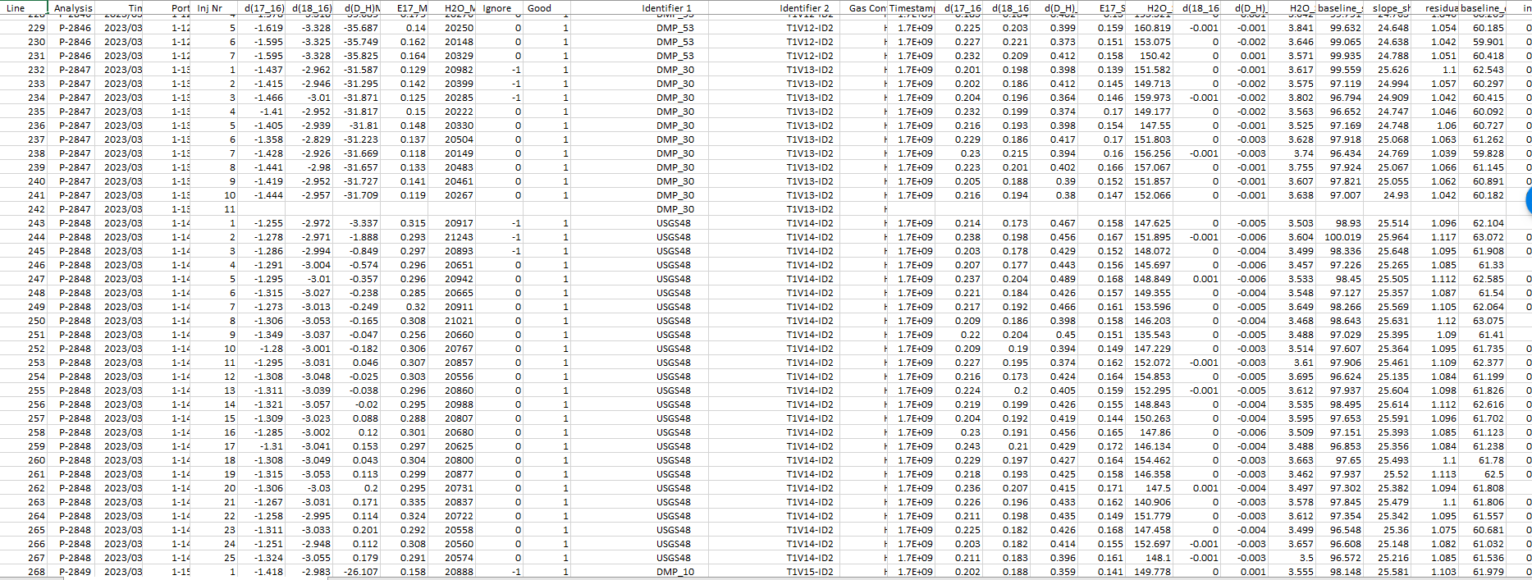

Slide 10
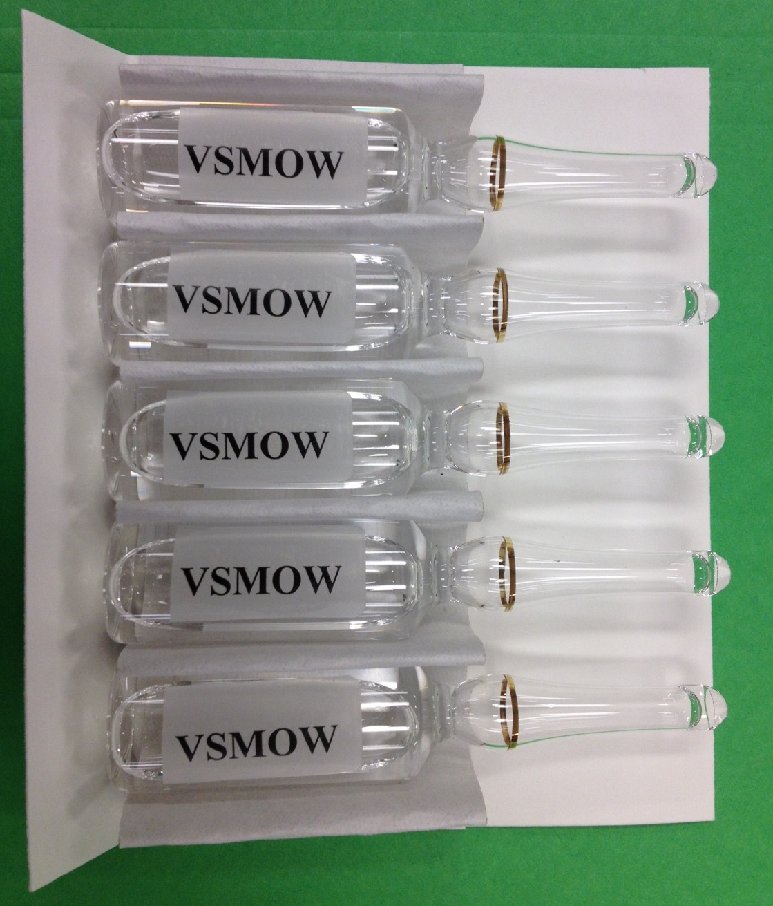
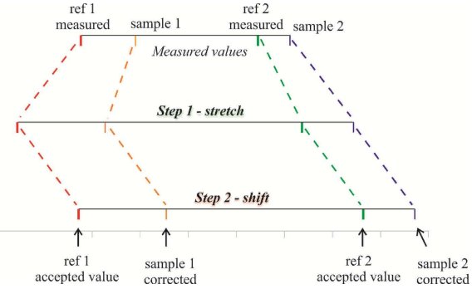
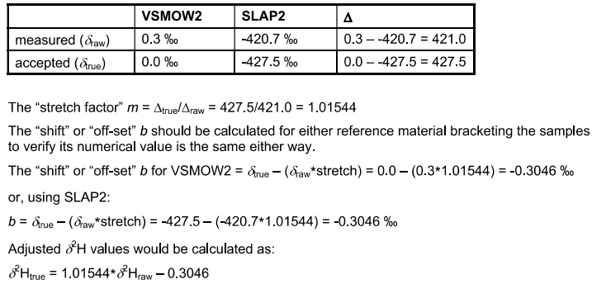

Slide 11
¹⁶O
¹⁷O
¹⁸O
¹⁶O
¹⁷O
¹⁸O
∆¹⁷O
∆¹⁷O
Raw
Corrected
¹⁷O
y=mx + b
¹⁸O
y=mx + b
+
=
¹⁷O Corrected
¹⁸O Corrected
Corrected ∆¹⁷O

Slide 12
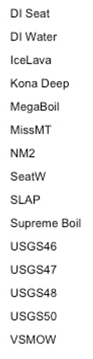
Samples
CSV
Xlsx

Slide 13
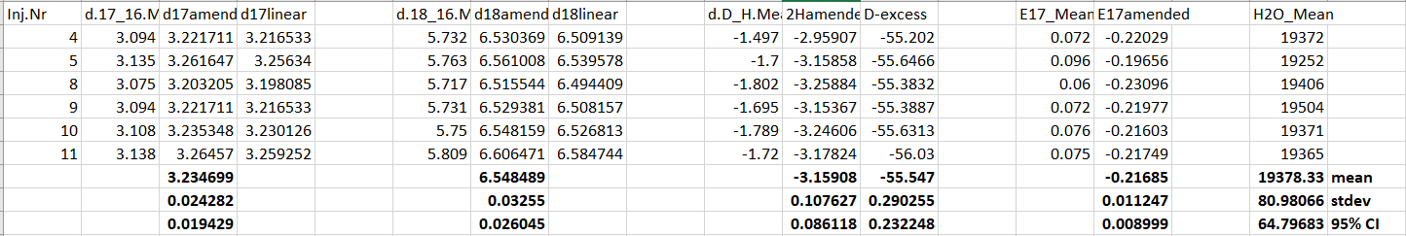
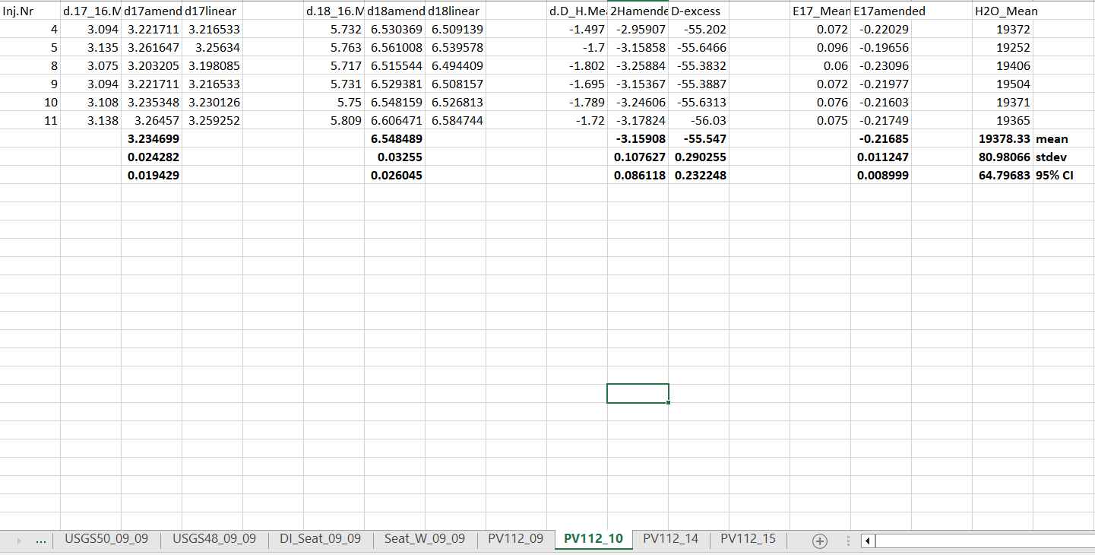

Slide 14
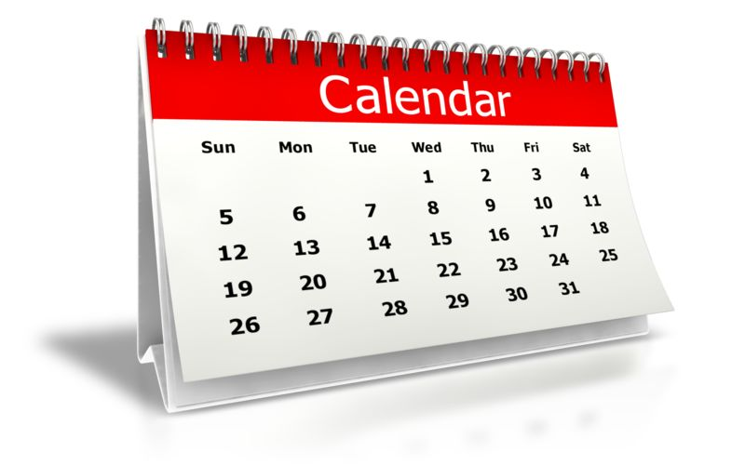
2-months
Standards Run
Sample | δ¹⁸O | Δ¹⁷O
MegaBoil | 8.315 | -13.870
SupremeBoil | 6.191 | -7.260
Kona Deep | 0.344 | -7.772
DI Water | -2.531 | 17.073
DI Seat | -6.245 | 15.147
Seattle Tapwater | -9.952 | 27.991
IceLava Bottled Water | -8.479 | 26.676
NM2 | -12.789 | 17.756
Missoula Tapwater | -16.921 | 24.425

Slide 15

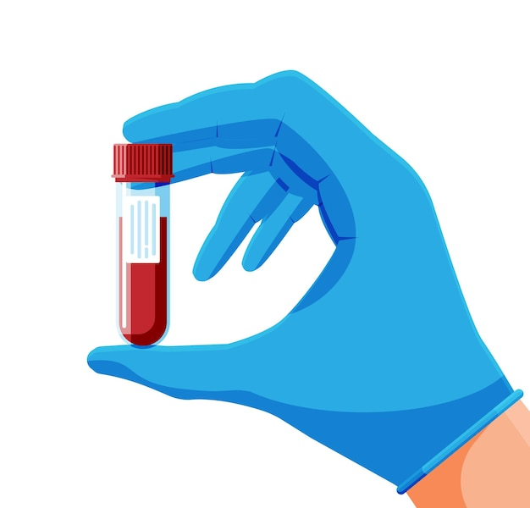
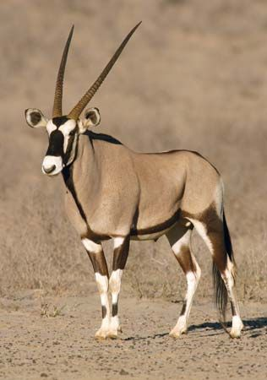
Analysis Run
Sample | δ¹⁸O | Δ¹⁷O
MegaBoil | 8.315 | -13.870
SupremeBoil | 6.191 | -7.260
Kona Deep | 0.344 | -7.772
DI Water | -2.531 | 17.073
DI Seat | -6.245 | 15.147
Seattle Tapwater | -9.952 | 27.991
IceLava Bottled Water | -8.479 | 26.676
NM2 | -12.789 | 17.756
Missoula Tapwater | -16.921 | 24.425

Slide 16
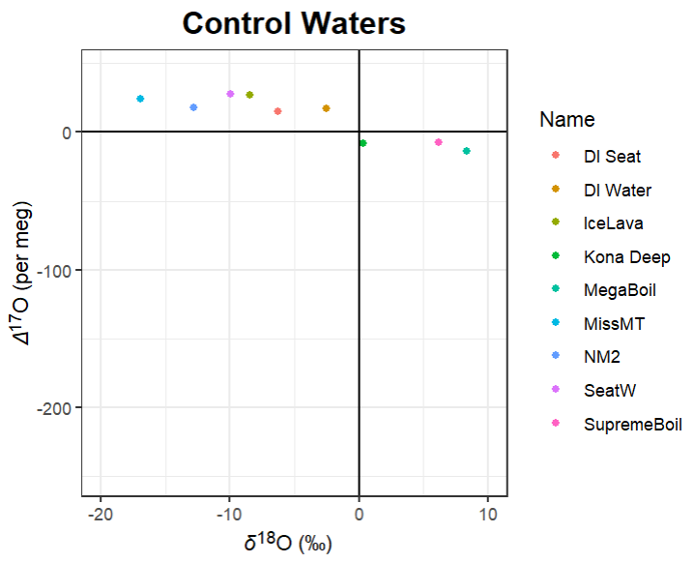
x
x
x
x

Slide 17
Next Steps….
Create packages for functions
Improve precision
Automate last few steps
Combine with database

